Slide 1
Forces Year 7 Science

Slide 2

Learning Objectives
CFU
What is one thing we are going to learn about forces?
Identify what forces are and what they can do
Distinguish between contact and non-contact forces
Explain how forces are measured
Activate Prior Knowledge
Consider these two objects:
On your whiteboard, make a list of all the things your foot could make a soccer ball do.
Notes:
CFU: 30 s, popsticks
APK: 30 s, show, popsticks

Slide 3
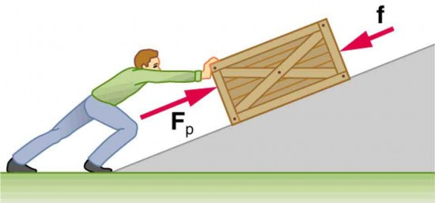
Concept Development
CFU 1
True or False: you must push something to create a force.
What is a force?
A force is any push or pull that happens when two objects interact.
There are many different types of forces. A simple push or pull is called an applied force.
We will be learning about other forces later.
CFU 2
How many objects are needed for a force to exist?
CFU 3
Think, Pair, Share: which force is the applied force in this diagram? What is the other force?
Vocabulary
force (noun) any push or pull that happens when two objects interact
Notes:
Read definition chorally
CFU 1: 10 s, show of hands
CFU 2: 10 s, fingers
CFU 3: 30 s, popsticks (ask questions separately)

Slide 4
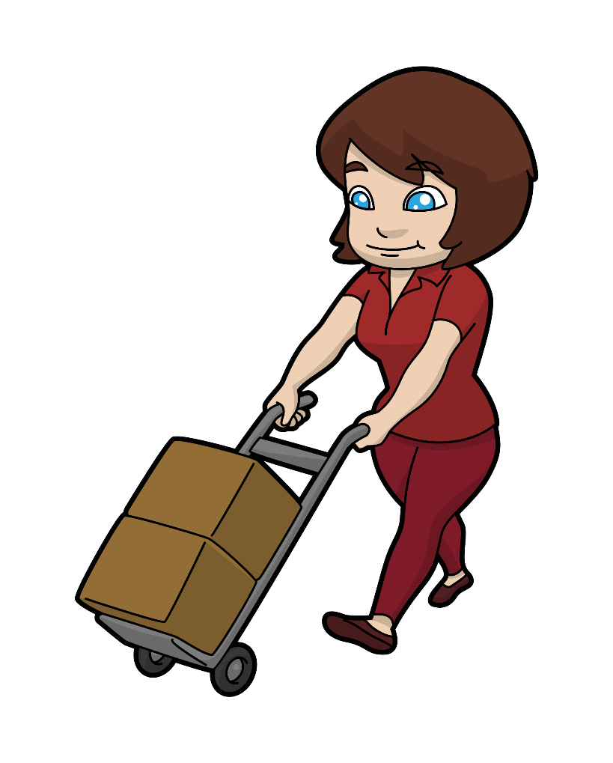
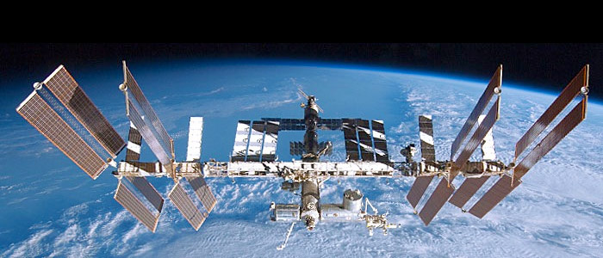
Concept Development
CFU 1
True or False: there can be a force between two objects that are not touching.
Contact and non-contact forces
There are two main types of forces:
Contact forces (the two objects need to be touching)
Non-contact forces (the two objects do not need to be touching)
CFU 2
Is an applied force a contact or non-contact force? Why?
CFU 3
Think, Pair, Share: what is the force keeping you on the ground? What type of force is it?
Vocabulary
applied force (noun) a simple push or pull
Notes:
Name types chorally
CFU 1: 10 s, show of hands
CFU 2: 10 s, show of hands, popsticks for explanation
CFU 3: 30 s, popsticks

Slide 5

Concept Development
CFU 1
What three things can a force change about an object?
What can forces do?
Forces can make objects:
Change speed
Change direction
Change shape
The same force will sometimes make more than one of these changes happen.
How are forces measured?
Forces are measured in Newtons (N for short, not n).
You can measure applied forces with scales or a spring balance.
CFU 2
Think, Pair, Share: which of these three changes will happen to the ball?
CFU 3
Brody says that forces are measured in kilograms. Is he correct? Why or why not?
Vocabulary
force (noun) any push or pull that happens when two objects interact applied force (noun) a simple push or pull
Notes:
Read list chorally
CFU 1: choral
CFU 2: 30 s, popsticks
CFU 3: 10 s silent, popsticks

Slide 6
Skill Development / Guided Practice
CFU 1
What is the first thing you need to mention when describing a force?
Describing Forces
When describing a force, you need to include:
What is pushing / pulling what
Any changes to the objects’
Speed
Direction
Shape
The tennis racket is pushing the ball. This is causing the ball to change speed, direction, and shape.
CFU 2
What three things might a force change about an object?
Vocabulary
force (noun) any push or pull that happens when two objects interact applied force (noun) a simple push or pull
Notes:
CFU 1: popsticks
CFU 2: popsticks

Slide 7

Skill Development / Guided Practice
Reminder
When describing a force, you need to include: What is pushing / pulling what Any changes to the objects’ Speed Direction Shape
Describe the force at work in the picture below.
The ________ is pushing / pulling the ________. This is causing the ________ to change ________.
Vocabulary
force (noun) any push or pull that happens when two objects interact applied force (noun) a simple push or pull
Notes:
1 min → share → popsticks

Slide 8
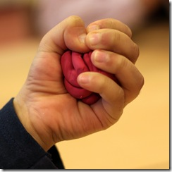
Skill Development / Guided Practice
Reminder
When describing a force, you need to include: What is pushing / pulling what Any changes to the objects’ Speed Direction Shape
Describe the force at work in the picture below.
The ________ is pushing / pulling the ________. This is causing the ________ to change ________.
Vocabulary
force (noun) any push or pull that happens when two objects interact applied force (noun) a simple push or pull
Notes:
45 s → share → popsticks

Slide 9
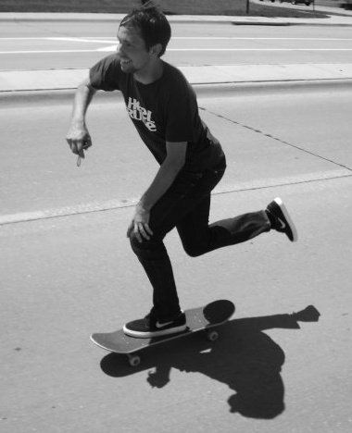
Skill Development / Guided Practice
Reminder
When describing a force, you need to include: What is pushing / pulling what Any changes to the objects’ Speed Direction Shape
Describe the force at work in the picture below.
The man is pushing the ground. This is causing the man to change speed.
Vocabulary
force (noun) any push or pull that happens when two objects interact applied force (noun) a simple push or pull
Notes:
45 s → share → popsticks

Slide 10
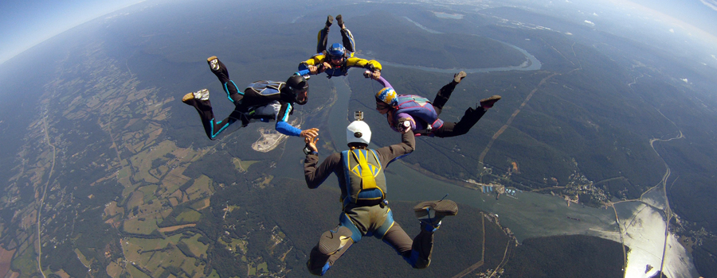
Skill Development / Guided Practice
Reminder
When describing a force, you need to include: What is pushing / pulling what Any changes to the objects’ Speed Direction Shape
Describe the force at work in the picture below.
The Earth is pulling the skydivers. This is causing the skydivers to change speed.
Vocabulary
force (noun) any push or pull that happens when two objects interact applied force (noun) a simple push or pull
Notes:
45 s → share → popsticks

Slide 11
Relevance
We are surrounded by forces: without them, nothing would move!
Forces are important in engineering, astronomy, architecture, sports, physiotherapy, and many other fields.

Slide 12
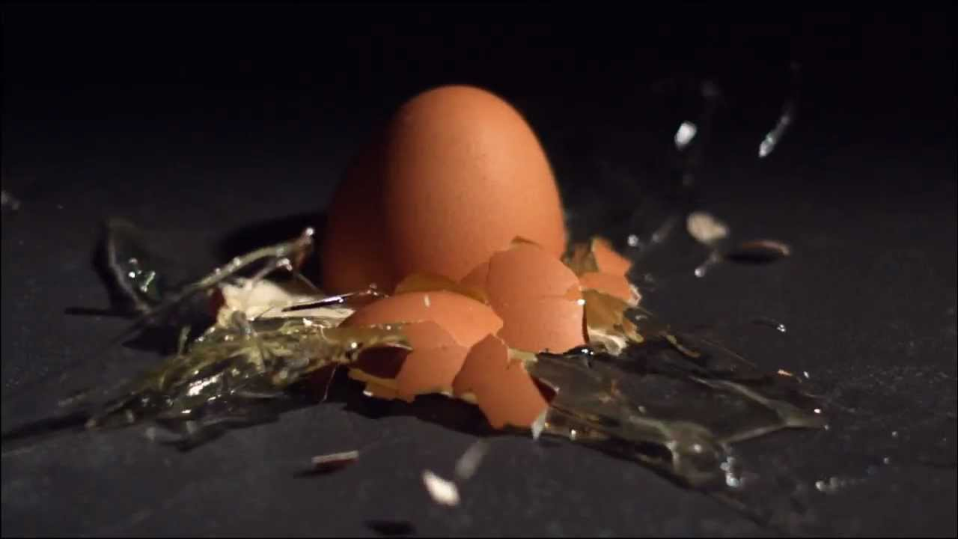
Skill Closure
Fill in the blanks: A force is a ____ or a ____ that happens when ____ objects interact.
Forces are measured in Newtons. What is a short way of writing Newtons?
Describe the force at work in this picture.
Reminder
When describing a force, you need to include: What is pushing / pulling what Any changes to the objects’ Speed Direction Shape
Notes:
Whiteboards, 2 mins

Slide 13
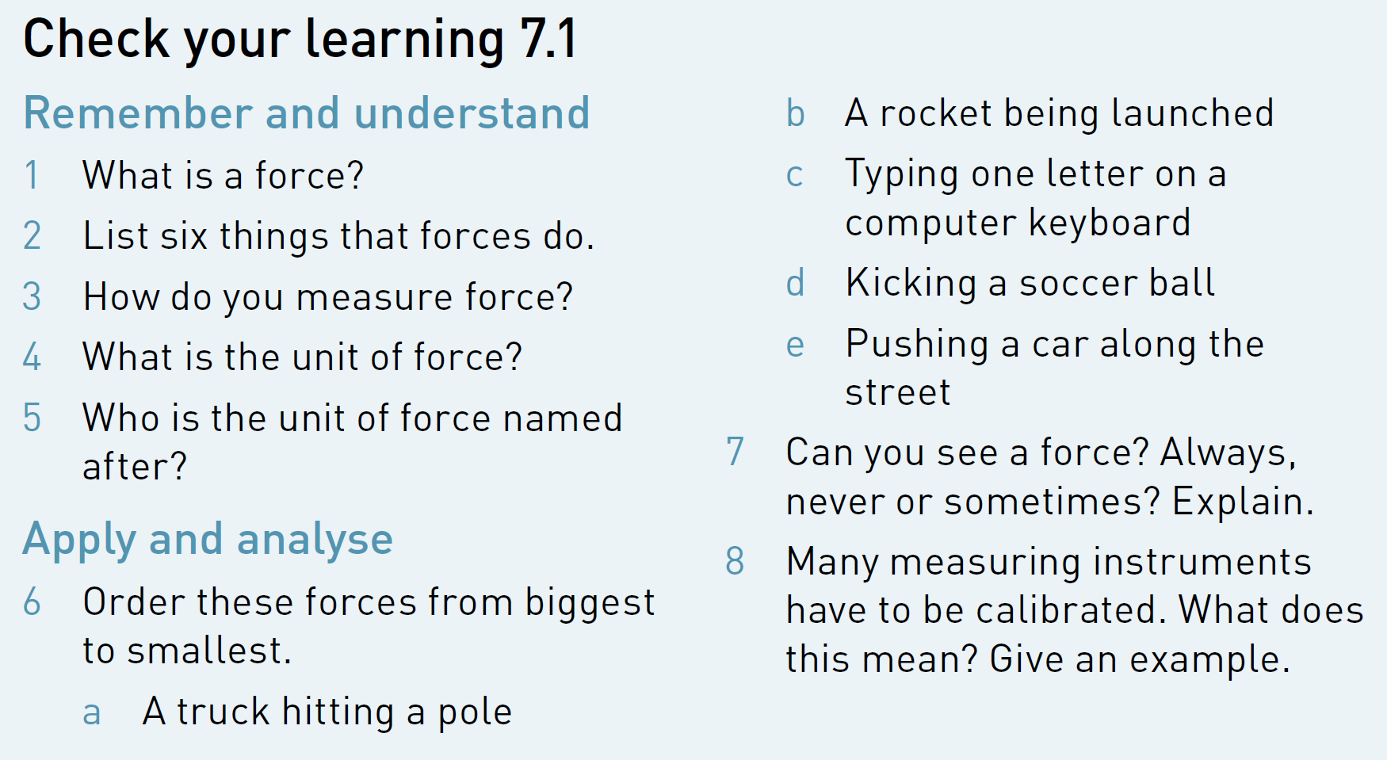
Independent Practice
Collect a textbook and complete questions 1-7 on page 121.

